Slide 1



> dotnet tour
Scott Addie
Senior Content Developer
@Scott_Addie

Slide 2



Build with Microsoft Tech
Explore developer tools, platforms, and APIs

Slide 3
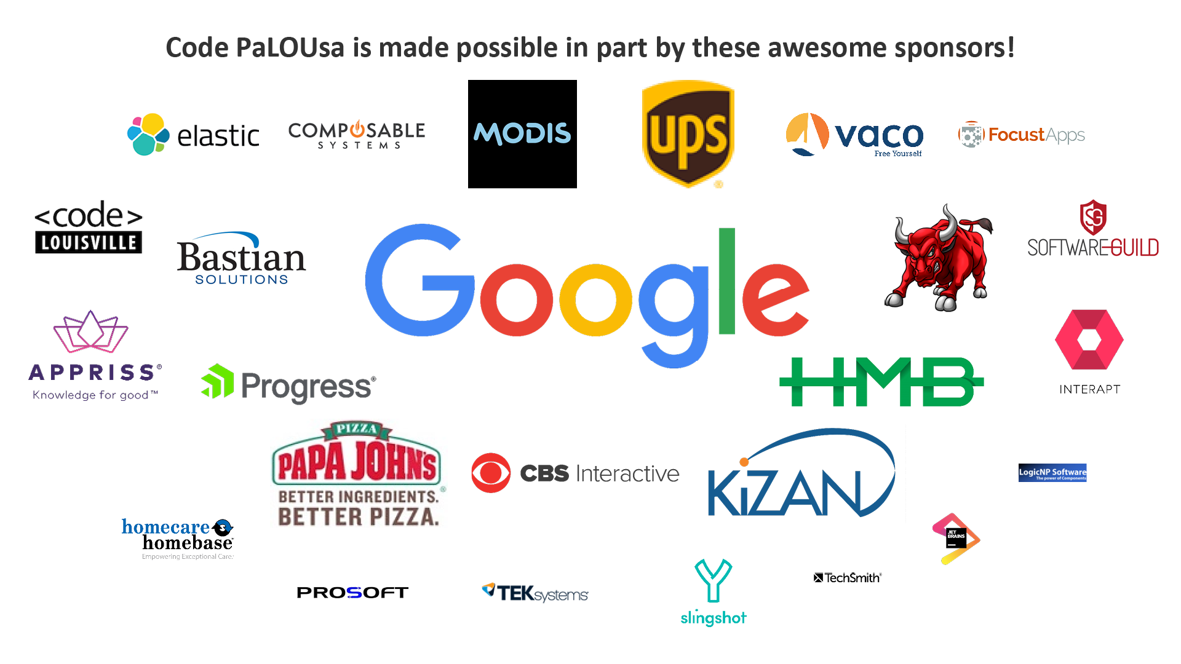

Slide 4
> dotnet tour|
Scott Addie
Senior Content Developer
@Scott_Addie

Slide 5
Agenda
CLI overview
Frequently used commands
VS Code integration
Scaffolding
Template creation

Slide 6



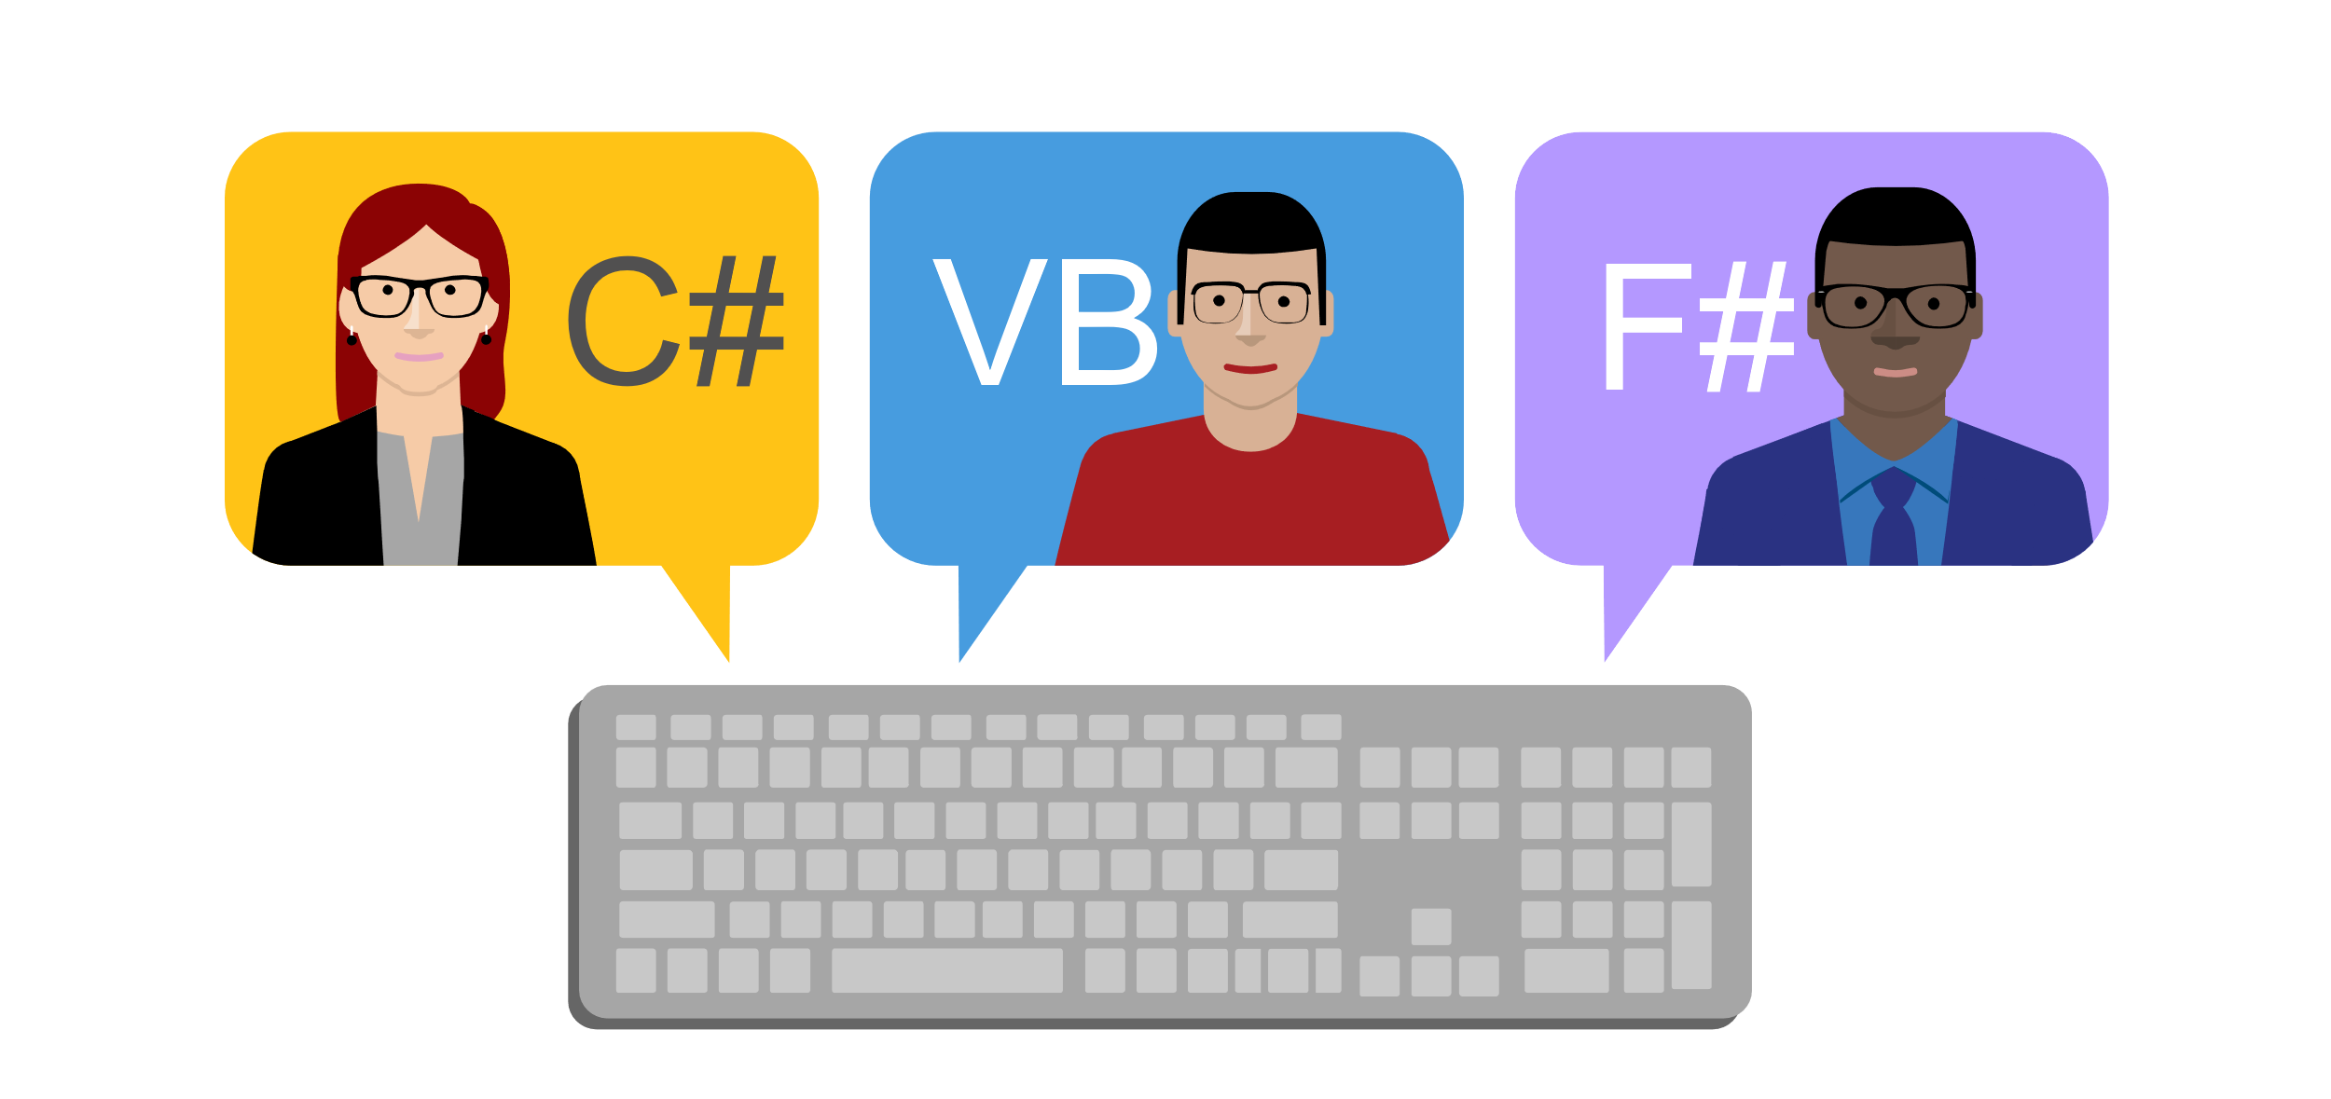
What is the .NET Core CLI?
Chassis on which tooling is built
Makes command line 1st class citizen
Works everywhere
Side-by-side installs
Multi-language support
Notes:
C:\Program Files\dotnet\sdk

Slide 7
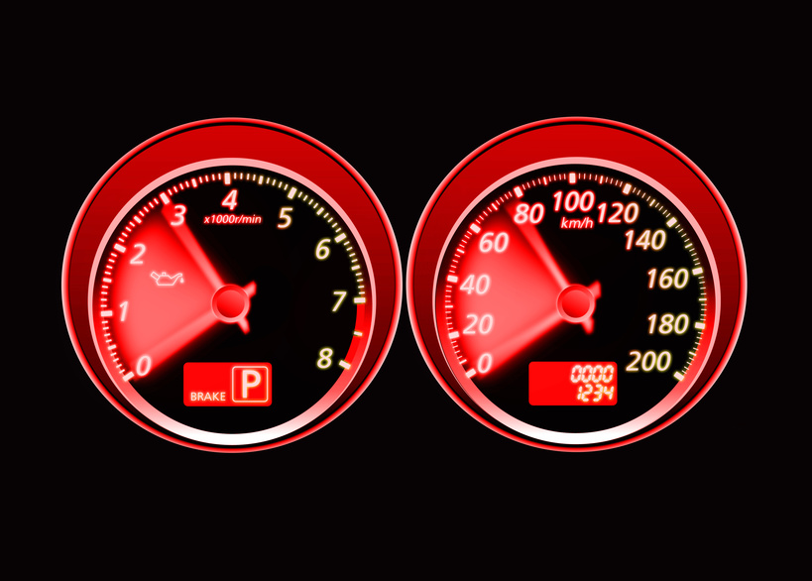

Learn abstraction below comfort zone
Visual Studio
Visual Studio Code
Visual Studio for Mac
.NET Core CLI
Notes:
Not all commands accounted for in tooling:
dotnet store (create runtime store)
dotnet publish (SCD) ← coming in VS 2017 15.7 Preview 3
Compare to GitHub for Windows vs. Git command line

Slide 8
Command structure
dotnet command [<arguments>] [<options>]
dotnet publish my_app.csproj -c Release
Notes:
- dotnet my_app.dll ← only case when dotnet is used w/o command

Slide 9
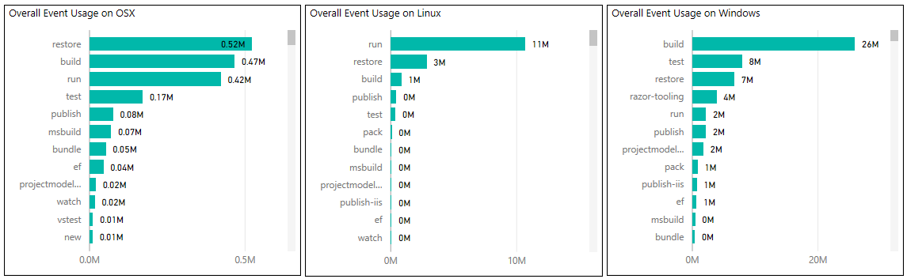
DEMO
Frequently used commands
Notes:
- gathered from telemetry in 7/2017

Slide 10
Integration with VS Code
Consistent experience on all platforms
Extensions:
C# (OmniSharp)
Azure CLI Tools
Use with…
Command Palette
Integrated Terminal
Tasks

Slide 11
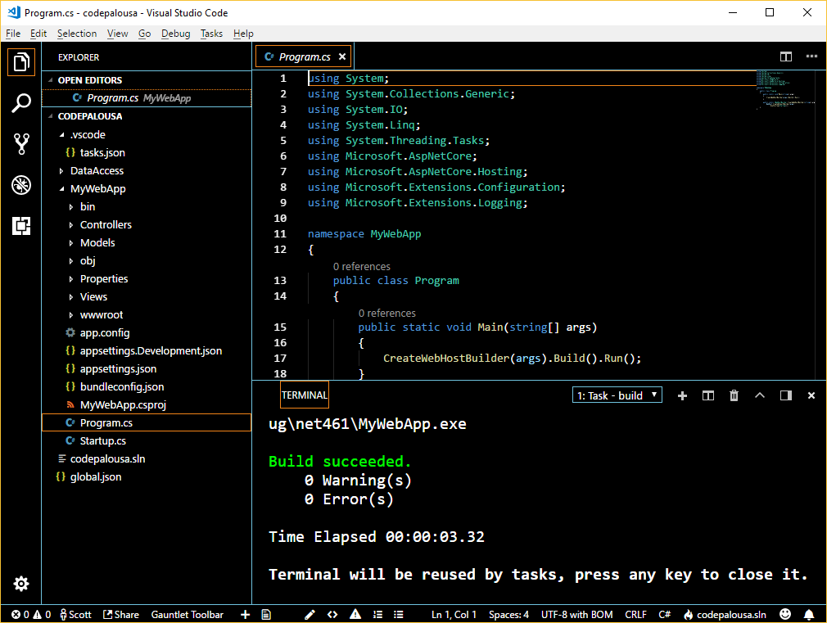

VS Code DEMO

Slide 12
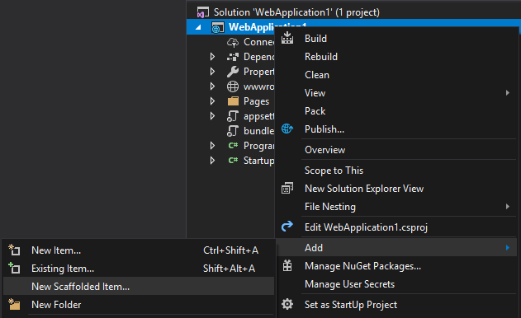
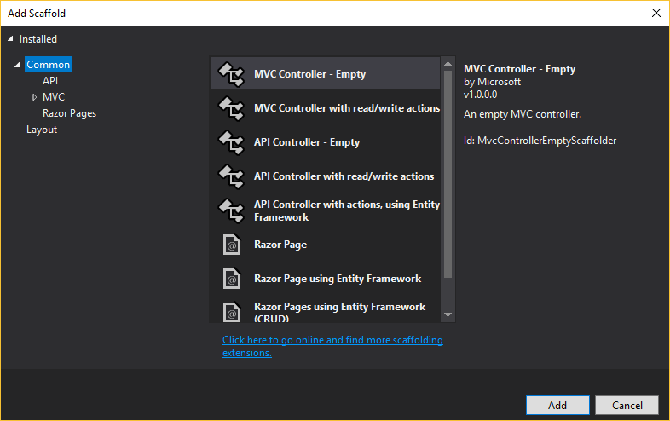
Right-click > Add > New Item…?

Slide 13
Scaffolding setup
C:\working_folder\test_app> dotnet aspnet-codegenerator -h Usage: aspnet-codegenerator [arguments] [options] Arguments: generator Name of the generator. Check available generators below. Options: -p|--project Path to .csproj file in the project. -n|--nuget-package-dir -c|--configuration Configuration for the project (Possible values: Debug/ Release) -tfm|--target-framework Target Framework to use. (Short folder name of the tfm. eg. net46) -b|--build-base-path --no-build Available generators: area : Generates an MVC Area. controller: Generates a controller. identity : Generates an MVC Area with controllers and razorpage : Generates RazorPage(s). view : Generates a view.
test_app.csproj
<Project Sdk="Microsoft.NET.Sdk.Web"> <PropertyGroup> <TargetFramework>netcoreapp2.1</TargetFramework> </PropertyGroup> <ItemGroup> <PackageReference Include="Microsoft.AspNetCore.App" Version="2.1.0-preview1-final" /> <PackageReference Include="Microsoft.VisualStudio.Web.CodeGeneration.Design" Version="2.1.0-preview1-final" /> </ItemGroup> <ItemGroup> <DotNetCliToolReference Include="Microsoft.VisualStudio.Web.CodeGeneration.Tools" Version="2.1.0-preview1-final" /> </ItemGroup> </Project>
Notes:
enables item template generation
can’t add Identity to proj. after creating in VS; you can with CLI

Slide 14
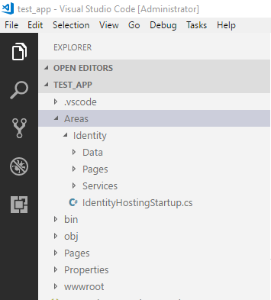
Scaffolding command
C:\working_folder\test_app> dotnet aspnet-codegenerator identity Building project ... Finding the generator 'identity'... Running the generator 'identity'... RunTime 00:00:15.93

Slide 15
Creation of templates
Create .template.config folder
Define metadata in template.json
Create .nuspec file
nuget pack <path_to_nuspec>
dotnet new -i <path_to_nupkg>
Notes:
works for project & item templates
NuGet steps optional if doing file system / network share installation
SideWaffle Template Creator extension for VS 2017 ← add templates to VS

Slide 16
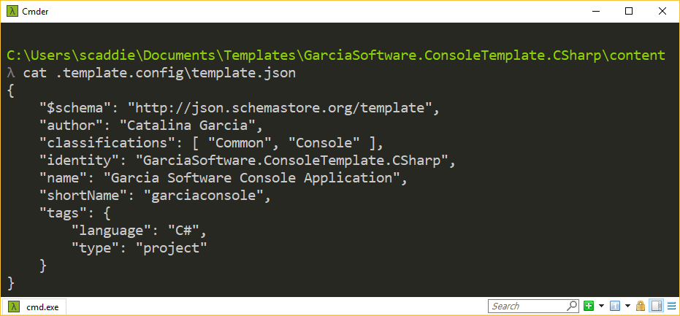
DEMO
Template creation

Slide 17
Integration with VSTS
CI / CD pipeline
Build definitions
Release definitions
CLI knowledge needed for advanced cases
Notes:
Release Management
Also applies to TFS
If using IDE / editor, you wouldn’t know CLI params to pass

Slide 18
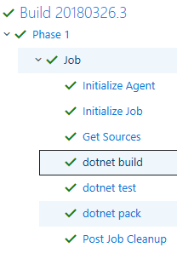
Build definition tasks
dotnet build 2018-03-26T19:30:30.5011481Z [command]"C:\Program Files\dotnet\dotnet.exe" build D:\a\1\s\TagHelperSuite.Sample\TagHelperSuite.Sample.csproj --configuration release … 2018-03-26T19:31:09.5408036Z [command]"C:\Program Files\dotnet\dotnet.exe" build D:\a\1\s\TagHelperSuite.Tests\TagHelperSuite.Tests.csproj --configuration release … dotnet test 2018-02-20T01:20:37.6023913Z [command]"C:\Program Files\dotnet\dotnet.exe" test D:\a\1\s\TagHelperSuite.Tests\TagHelperSuite.Tests.csproj --configuration release --logger trx --results-directory D:\a\_temp 2018-02-20T01:20:38.6943014Z Build started, please wait... 2018-02-20T01:20:41.0551162Z Build completed. …

Slide 19
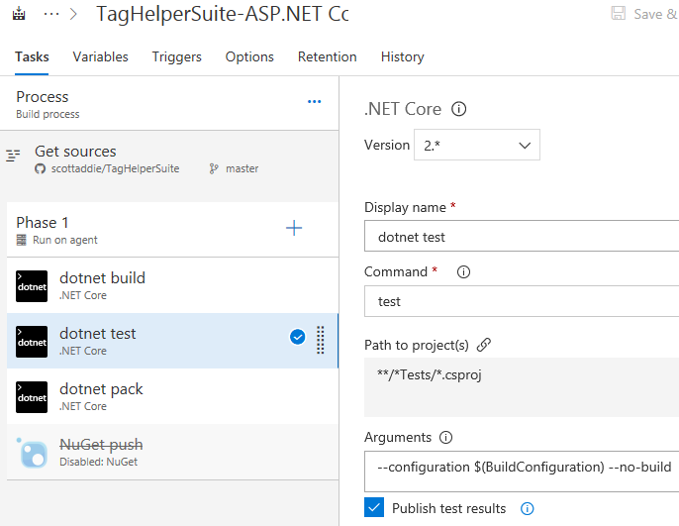
Customize build definition task
dotnet test 2018-03-26T19:11:13.3481702Z [command]"C:\Program Files\dotnet\dotnet.exe" test D:\a\1\s\TagHelperSuite.Tests\TagHelperSuite.Tests.csproj --configuration release --no-build --logger trx --results-directory D:\a\_temp …

Slide 20


Thank you!
Slides: aka.ms/N44not
Gists:
Commands:
aka.ms/Mbozcr
Templates:
aka.ms/Bhaecq
docs.microsoft.com/dotnet/core/tools
@Scott_Addie

